Slide 1
Myntra Sales Analysis Dashboard

Slide 2
Business Requirements
Develop KPIs for revenue, orders, sales amount, and total products.
Implement filters for year, category, brand, and subcategory.
Identify top-selling brands and their revenue in millions.
Analyse owned brands and their total product count.
Create a chart for daily sales distribution by category.
Track total sales and discounts by month.
Visualize total sales with year-on-year comparison by category using a ribbon chart.
Determine total sales by category for each state.
Identify the best-selling product within each category.
Create a matrix detailing brand-wise total orders, discounts, average sales amount, and total sales.

Slide 3
KPIs for revenue, orders, sales amount, and total products.
These are the KPIs created based on the business requirements. There we have data from the year 2021 till 2023. So the total orders is 3.5K, Average Sales amount, Total sale amount, Total Revenue, Average Discount %, Total Products.

Slide 4

Filters for year, category, brand, and subcategory
Since the dataset contains data of 2021,2022,2023 I have created tile format slicer and also for Category section because we have only 4 category. The brand name and sub category contains many names so I have created dropdown list for that.

Slide 5
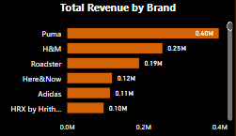
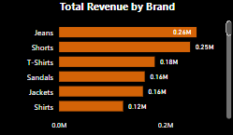
Top-selling brands and their revenue
Here I have created a stacked bar chart to display the total revenue based on brand and also provided drill down options for viewing the most sold products with there values. Here Puma brands generates the most and in products we have jeans that sold most.

Slide 6
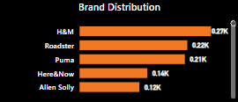
Brand Distribution
Here we have H&M brand which have most of the products 27K in myntra and we can now compare there sales data with it to generate insights for the further analysis.

Slide 7
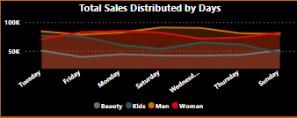
Sales distribution by category and Days
This chart represents day wise sales based on category and we can see that beauty products shows no spike for all days so we need to analyze the reason, whether offers were provided for those products. Women products have dipped on wednesdays and mens products are dipped on Friday. So try to provide discounts on Wednesdays for women and Friday for men to increase the sales.

Slide 8
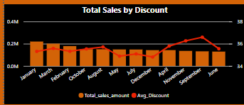
Sales and Discounts by month
Here we can see that most of the sales was done on January even if the discount was 35-36% sales have increase due to new year sales and new products that was released on new year time. We know that during the month of September sales will be down so the discount was increased to 36-37%, even though the discount was increased sales was down. So we need to figure out a way and try to bring new kinds of offers that attract people to buy.

Slide 9
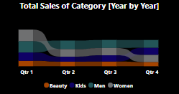
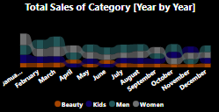
Total sales with year-on-year comparison by category
Here sales for beauty products is not raised for the whole year this is result due offers and less of beauty products collections. There is continues decrease in sales of women products and small increase in men products. Since this data is from post pandemic most of the people was not in a stable jobs so this may be one of the reason.

Slide 10
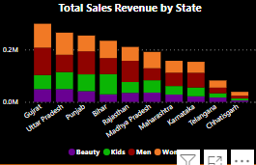
Total sales by category for each state
Here we can see that Gujrat have more sales compare to other states. Karnataka being the 3 least sales, we need to analyze this data since Mumbai, Karnataka is IT hub of India, have many small & large scale industries generating more revenue but the sales was done way less. The data shows 2023 have least sales compare to other data, one of the reason was global economic crisis in due this many have lost there jobs and many be due to this sales have reduced. Also need to gain insights about the other states also.

Slide 11
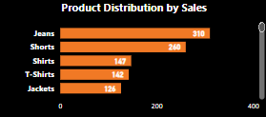
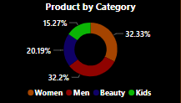
Best-selling products within each category
We can see that Jeans and shorts are best selling products. Jackets being least selling, need to provide best offers for jackets during seasonal time. T-shirt sales is also less, try to bring more collections and try to create a survey to know the customer mindset, so that we can try to increase the sales.

Slide 12
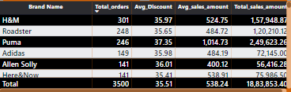
Matrix detailing brand-wise total orders, discounts, average sales amount, and total sales.
Here we can know the overall view of the brands and their key parameters that needs to be known based of each brand.

Slide 13
Thank You
G.ROSHAN MINAAL

